Slide 1
Reproductive System Notes

Slide 2
Warm Up: 5.4.2015
What does the endocrine system do for the body?
Challenge: How do you think a doctor could tell if your endocrine system wasn’t functioning correctly?

Slide 3
Reproductive System Notes
Extra Examples/Notes | Your Notes | Corrections
 | Introduction
As we go through the notes, check YOUR NOTES against what’s written in red and underlined.
If you made a mistake or left out a detail, write the correct notes in the “corrections” column
If you hear a fact or example that helps you understand, you can write it in the “extra” first column.

Slide 4
Introduction
The Endocrine System controls many of the changes that occur as a child matures; hormones.

Slide 5
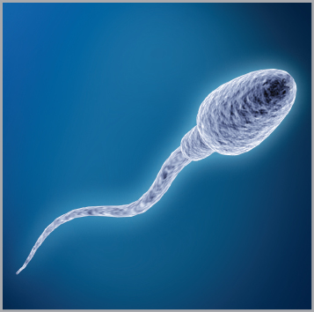
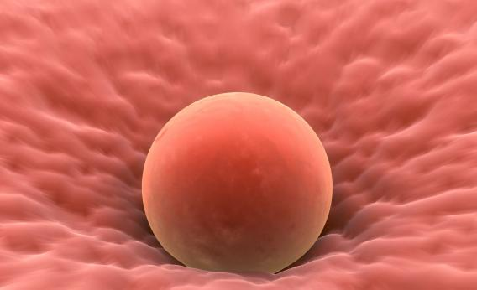
Sex Cells
Egg- female sex cell Sperm- male sex cell

Slide 6
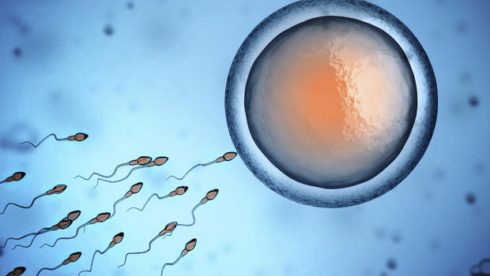
Fertilization- the joining of a sperm and an egg
Reproduction- the process by which living organisms produce new individuals of the same type.

Slide 7
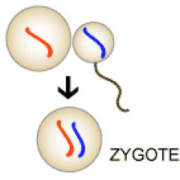
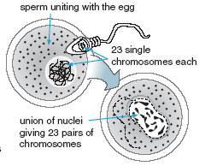
Zygote- A fertilized egg

Slide 8
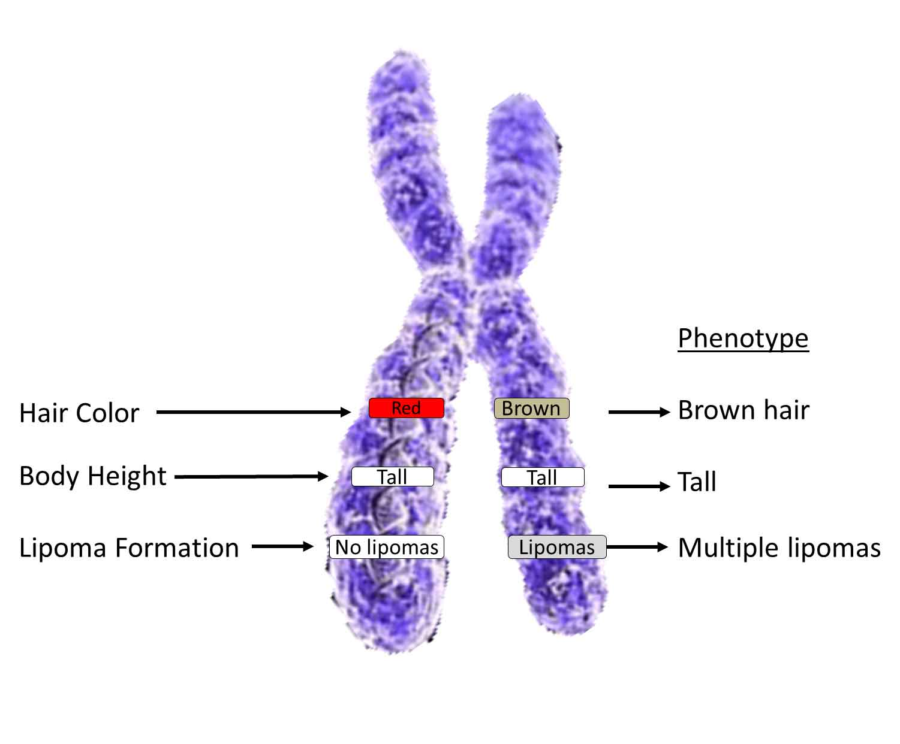
Chromosomes-
Found in cells
Carry info. that controls
inherited characteristics
Ex. Eye color & blood type.

Slide 9
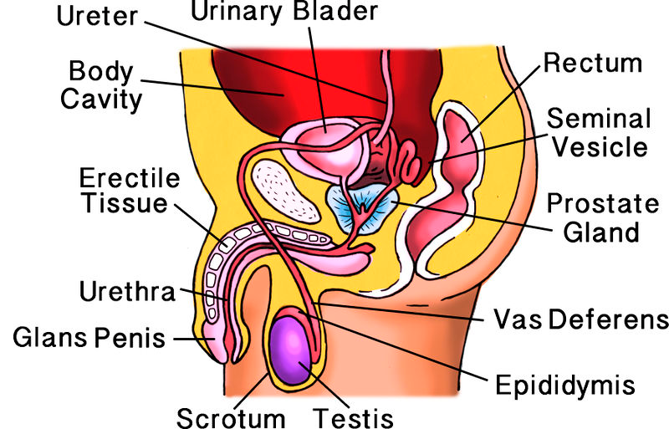
Male Reproductive System
Specialized to produce sperm and the hormone testosterone.

Slide 10
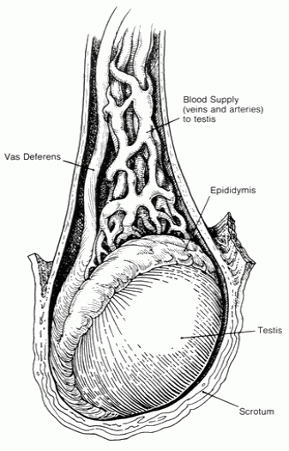
Male Reproductive System (next page)
Testes- oval shaped organs of the male reproductive system.
Clusters of 100s of tiny coiled tubes that produce sperm.
Produce the hormone testosterone.

Slide 11
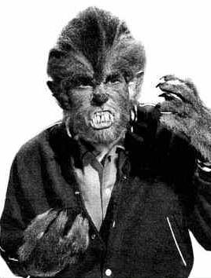
Male Reproductive System
Testosterone controls the development of physical characteristics in men.
Ex. Facial hair & deep voice, ability to produce sperm.

Slide 12
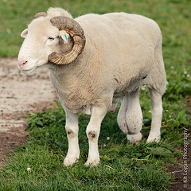
Male Reproductive System
Scrotum- external organ; pouch of skin.
- keeps testes about 2* to 3*C below the usual body temp of 37*C.
- sperm need the slightly cooler conditions to develop normally.

Slide 13
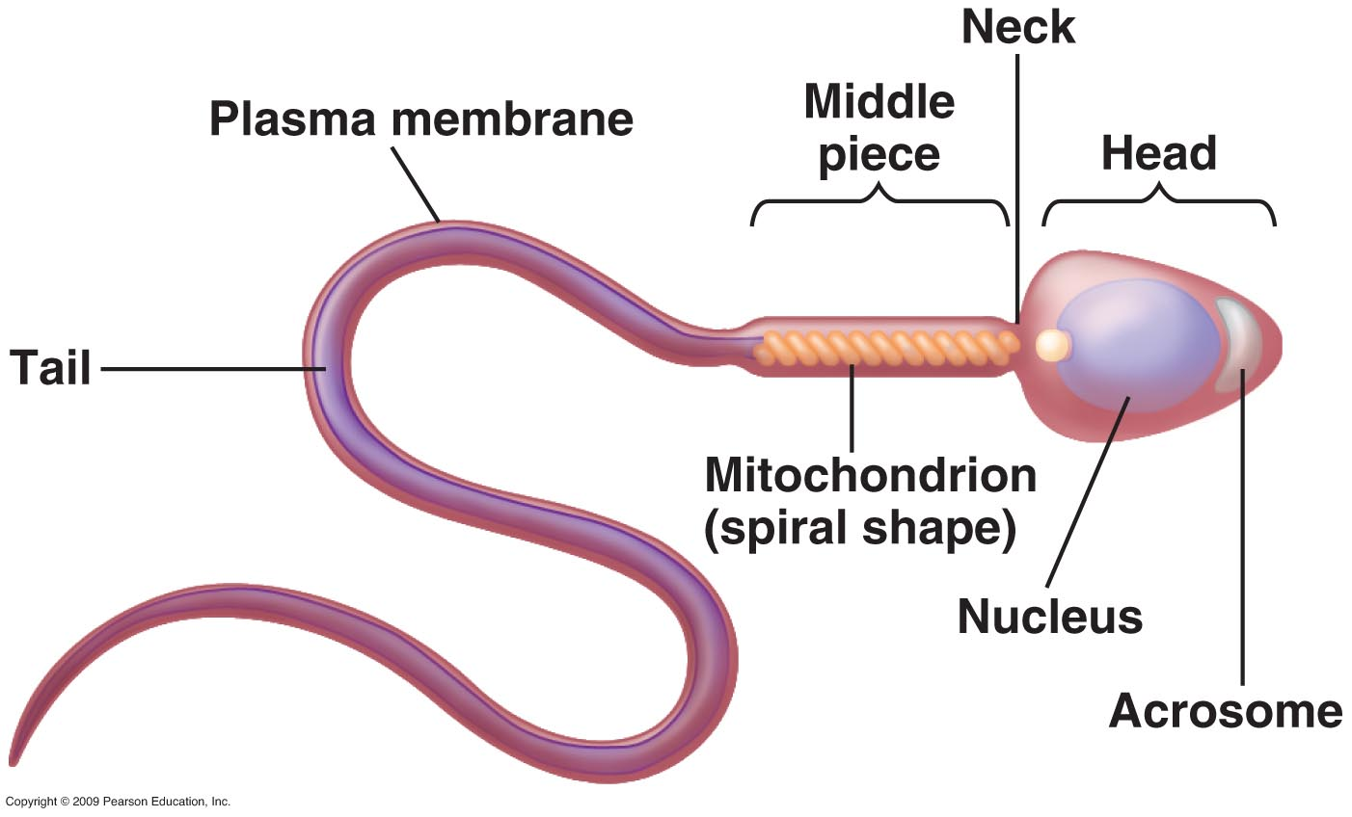
Sperm Production
Males start producing sperm during the teenage years.
The sperm head contains chromosomes.
The sperm tail is whip-like (to help it swim).

Slide 14
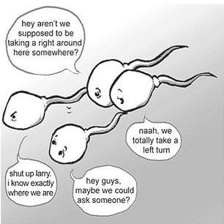
Path of Sperm Cells
Sperm travel through other structures
in the male reproductive system.
To get from the testes to the outside of the system, the male reproductive system has to create fluid to help the sperm swim!

Slide 15
Semen
Mixture of sperm cells and fluids.
Contains a HUGE number of sperm- about 5 to 10 million per drop.
Contains nutrients that the moving sperm use as a source of energy.

Slide 16
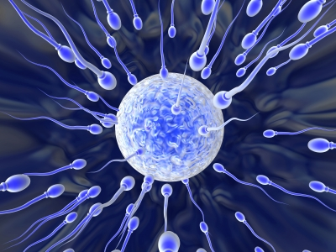
FACT!
Males produce between 40 million and 1.2 billion sperm EVERY time they have sex.
It only takes ONE of those sperm to fertilize an egg (pregnancy).
Don’t like the odds? Don’t have sex!!! Remember…it only takes ONE

Slide 17
Male Reproductive System: Penis
Body organ through which the semen leaves.
Urethra the tube through which the semen travels as it leaves the body.
Muscles near bladder contract, and prevent semen and urine from mixing.

Slide 18
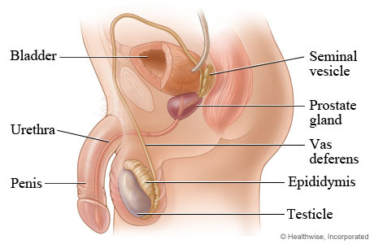
What two structures are the same in both men and women on this picture?

Slide 19
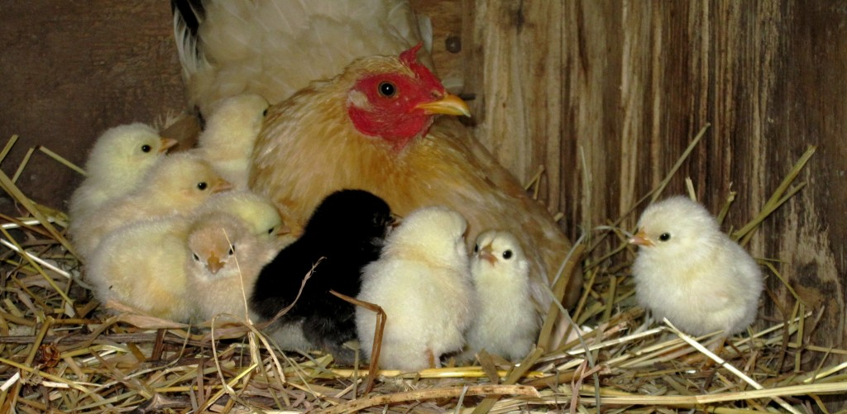
Female Reproductive System
-The role of the female reproductive system is to produce eggs, and if an egg is fertilized, to nourish a developing baby until birth.

Slide 20
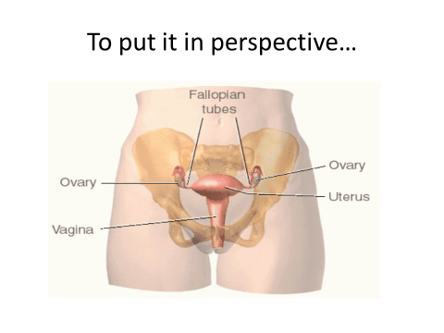
Ovaries
Located slightly below the waist,
one on each side of the body.

Slide 21
Female Reproductive System (next page)
Major role is to produce egg cells
To also produce hormones such as estrogen.
Estrogen triggers development of some adult female characteristics.
Ex. Hips widen, & the breasts develop. Estrogen also plays a role in the process by which egg cells develop.

Slide 22
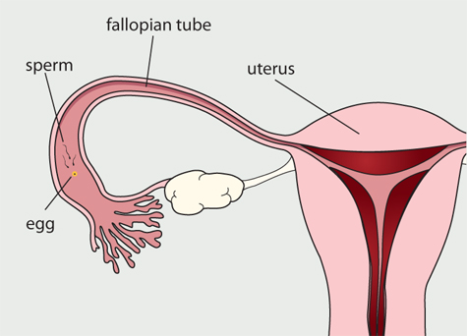
Path of Egg Cell
Oviducts A.K.A. fallopian tubes-passageways for eggs.
Located near the ovaries.
Most fertilization takes
Place in the oviducts.
(remember, the sperm are
From the male)

Slide 23
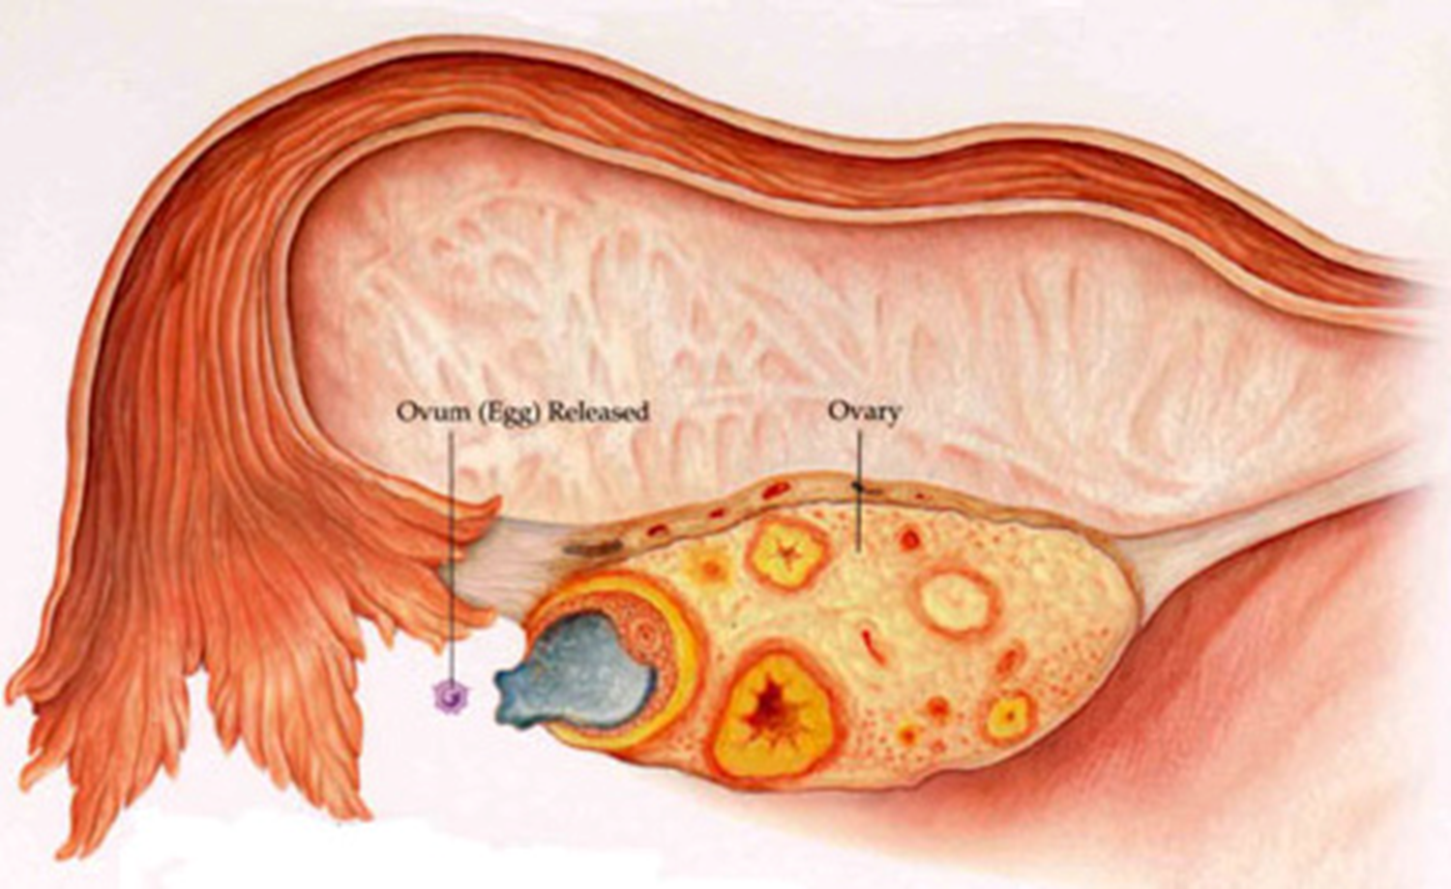
Path of Egg Cell
-mature egg released from ovaries each month, which enters the nearest oviduct (tube).

Slide 24
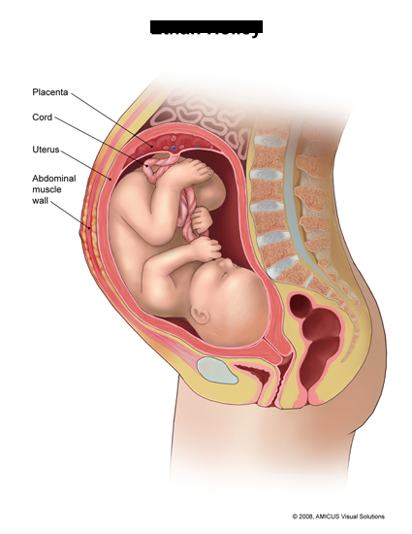
Path of Egg Cell
Egg travels in fallopian tube to
uterus (AKA the womb)
Uterus- hollow muscular organ about
the size of a pear.
If the egg has been fertilized, it
remains in the uterus and
begins to develop.

Slide 25
Path of Egg Cell
Fertilized egg remains in the uterus and begins to develop
Unfertilized egg breaks down as it enters the uterus

Slide 26
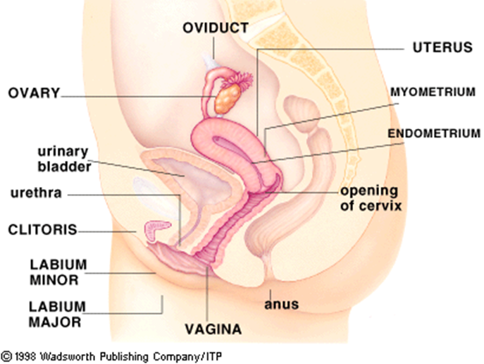
Path of Egg Cell
Vagina- egg enters through the cervix
(the vagina is also known as the birth canal)

Slide 27
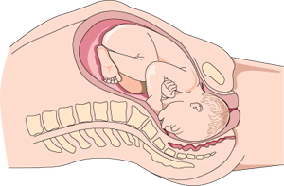
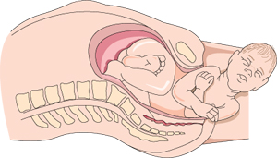
Vagina
Muscular passageway leading to the outside of the body.
A baby leaves the woman’s body through the vagina during birth.

Slide 28
Menstrual Cycle
400,000- number of undeveloped eggs in a woman’s ovaries.
Approximately 500 will actually leave the ovaries and reach the uterus.

Slide 29
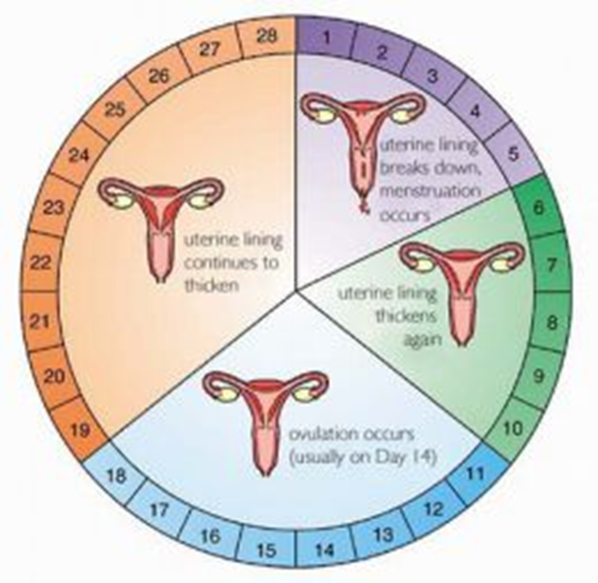

Slide 30
Menstrual Cycle-
Menstrual cycle-monthly cycle of changes that occur in the female reproductive system.
During this time-an egg develops in an ovary.
Also, the uterus prepares for the arrival of a fertilized egg.

Slide 31
Stages of (Menstrual) Cycle- (back page)
Cycle begins-when an egg starts to mature in one of the ovaries.
Lining of the uterus begins to thicken.
Approximately ½ way through the cycle-the mature egg is released into an oviduct.

Slide 32
Stages of (Menstrual) Cycle
Ovulation – process in which a mature egg is released from an ovary to an oviduct.
After ovulation- an egg can be fertilized for the next few days if sperm is present.
Unfertilized egg and thickened uterine lining break down.

Slide 33
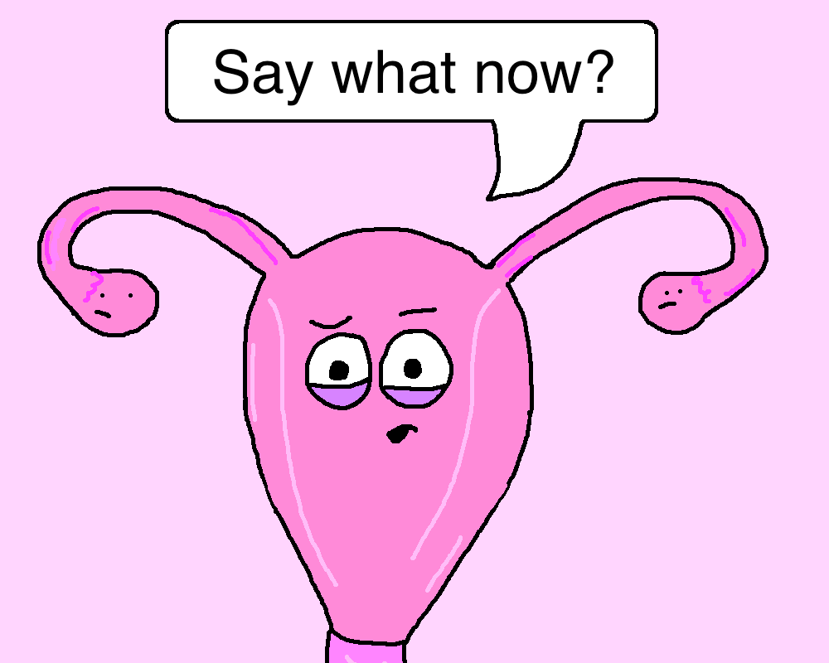
Menstruation
Menstruation-passing of the unfertilized egg and uterin lining through the vagina. Lasts about 4-6 days.
At time of menstruation a new egg begins to mature in the ovary.

Slide 34
Endocrine Control
Menstrual cycle triggered by hormones
Menstruation (usually) begins between the ages of 10 and 14.
Menstruation (usually) ends around age 50. (Menopause)

Slide 35
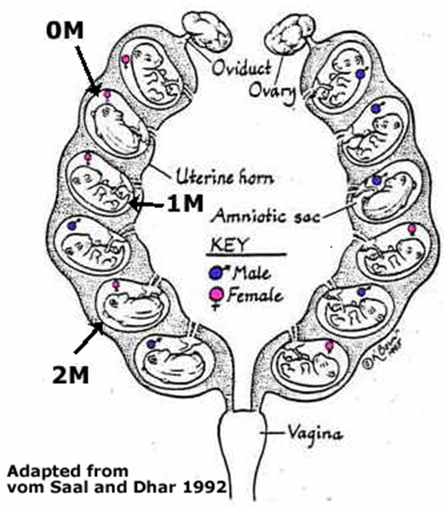
And if you think humans are weird inside, check this out…
Mouse Uterus

