Slide 1
Quick Review: What is Ecology??
Definition: The study of interactions that take place between organisms and their environment.
It explains how living organisms affect each other and the world they live in.

Slide 2
Review: What are examples of abiotic factors?
Abiotic factors- the nonliving parts of an organism’s environment.
Examples include air currents, temperature, moisture, light, and soil.

Slide 3
Review: What are biotic factors?
Biotic factors- all the living organisms that inhabit an environment.
All organisms depend on others directly or indirectly for food, shelter, reproduction, or protection.

Slide 4
Levels of Organization
Ecologists have organized ecosystems into different levels according to complexity.
Lets start with the simplest and work our way up to the largest.

Slide 5
1st Level of Organization
Species:
A group of organisms that are physically similar and can reproduce with each other to produce fertile offspring.

Slide 6
2nd Level of Organization
Population: all of the members of the same species, that live in the same area.

Slide 7
3rd Level of Organization
Community: All the populations of different species that live in the same area.

Slide 8
4th Level of Organization
Ecosystem: Populations of plants and animals that interact with each other and abiotic factors in a given area.

Slide 9
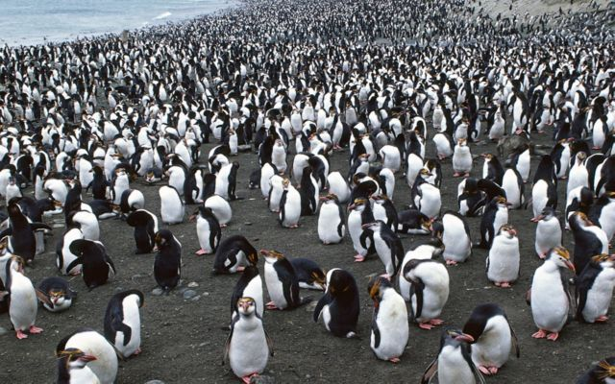
Population – all the individuals of a species found in the same area at the same time

Slide 10
Growth Rate – the amount that a population’s size changes over a period of time
Growth Rate =
(Birth Rate + Immigration Rate)
– (Death Rate + Emigration Rate)

Slide 11
Write the word and make your own mnemonic device.
Birth Rate – the number of births in a population over a period of time
Immigration Rate – the number of individuals that move into a population over a period of time
Death Rate – the number of deaths in a population over a period of time
Emigration Rate – the number of individuals that exit a population over a period of time

Slide 12
Doubling Time – the approximate time that it takes for a population to double
Doubling Time =
Time₁ Population • (Time₂ – Time₁)
Time₂ Population – Time₁ Population

Slide 13
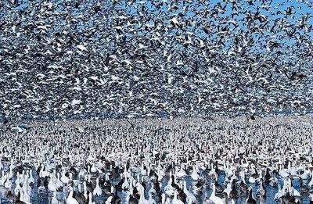
Population Density – how crowded a population is in an area

Slide 14
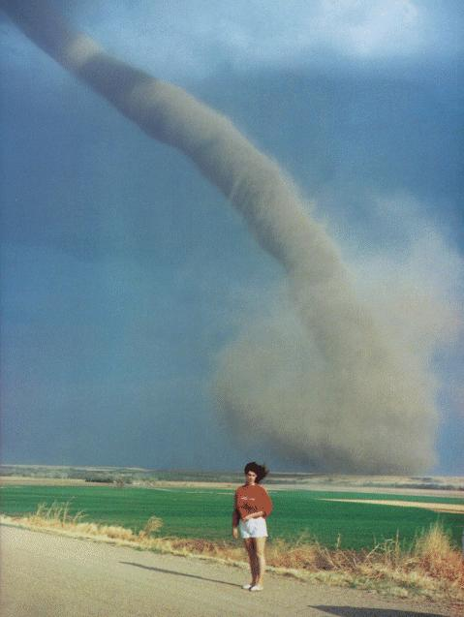
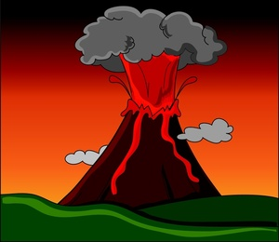
Density-Independent Factor – a factor that reduces a population’s size regardless of the population density
Examples: Disastrous weather, earthquakes, and volcanic eruptions

Slide 15
Density-Dependent Factor – a factor that reduces a population’s size when the population density becomes too great
Examples: Resources, predators, and disease
Food and predators are density dependent factors!

Slide 16
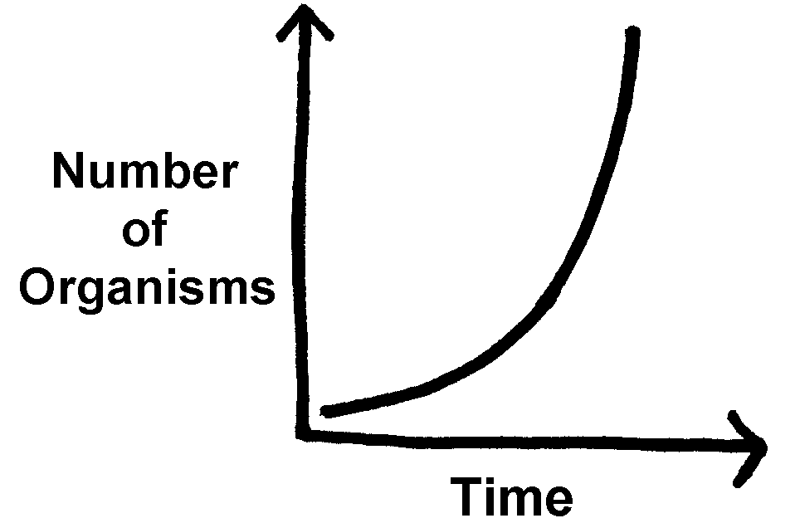
Exponential Growth Graph – a graph with a population that continues to grow exponentially
until it reaches a limiting factor and then either levels off in numbers or drastically decreases to a low number

Slide 18
Something causes the population growth to stop!
Limiting Factor – a density-dependent factor that prevents a population from exceeding a certain number of individuals

Slide 19
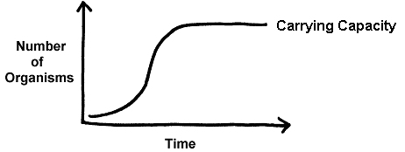
Logistic Growth Graph – a graph with a population that starts out growing exponentially and then levels off in numbers at its carrying capacity
Carrying Capacity – the maximum number of individuals that an environment can support over a long period of time

Slide 20
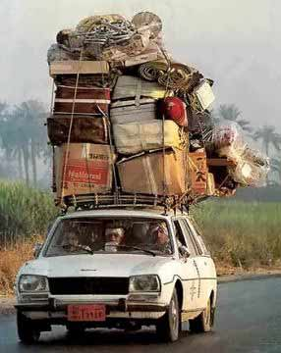
Carrying Capacity
Like this car, an ecosystem can only hold so many things in balance…

Slide 21
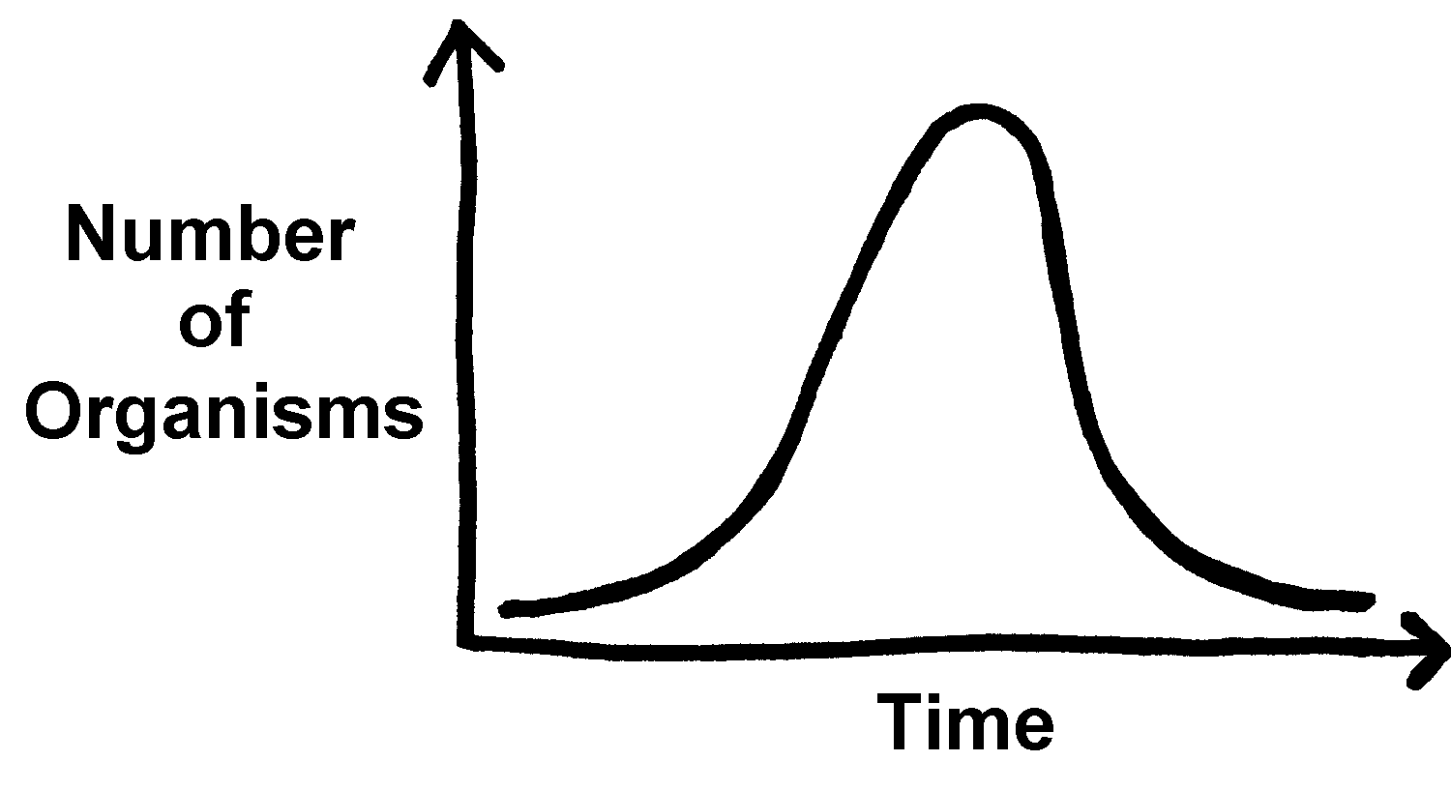
Boom and Bust Growth Graph – a graph with a population that continues to grow exponentially and then drastically decreases to a low number

