Slide 1
GROWER
The characteristics of life.
HANDOUT NUMBER 2

Slide 2
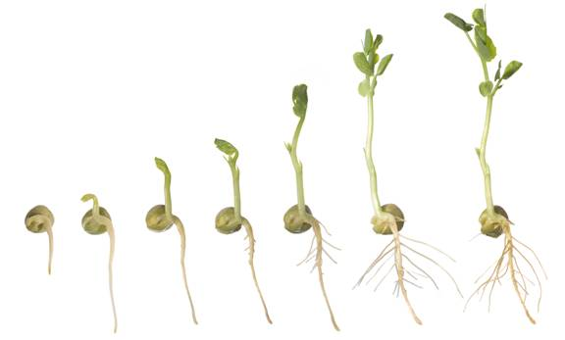
Growth
Increases in size over time.

Slide 3
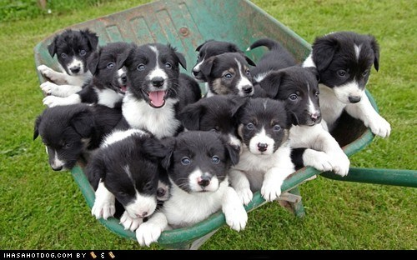
Reproduce- makes more individuals from itself, helps the species survive.

Slide 4
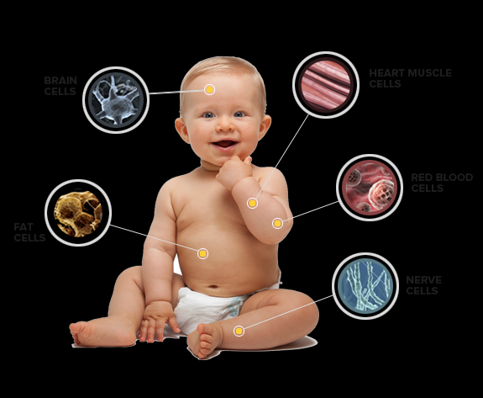
Organized- living things have organized cells and structures that help them perform functions to stay alive.

Slide 5
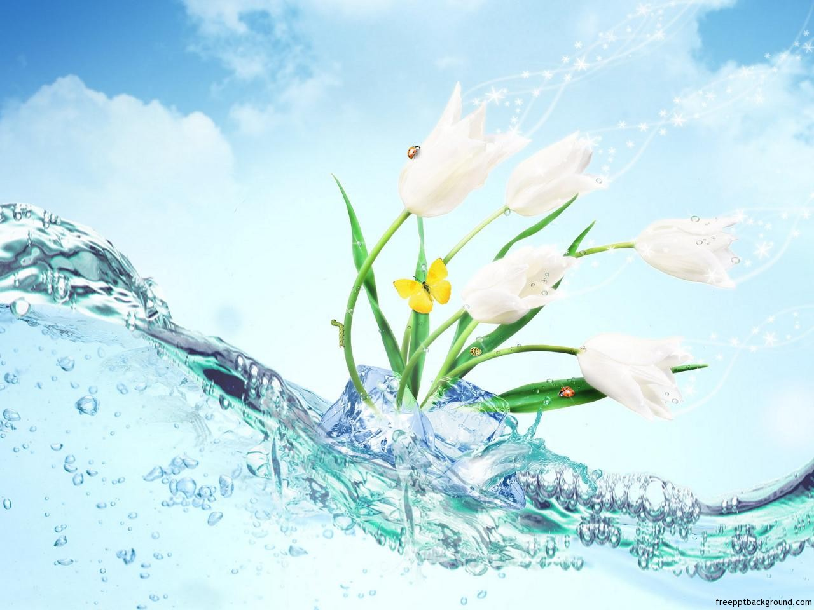
Water- living things need water to keep functioning.

Slide 6
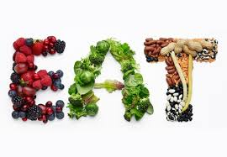
Energy- all living things are able to take in food and use if for their daily fuel. Plants make their own food for energy, everything else “eats” to get energy.

Slide 7
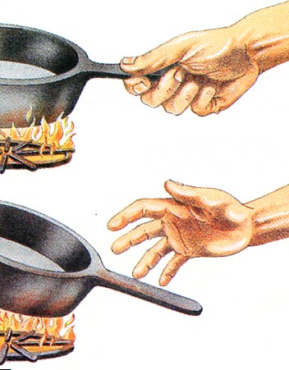
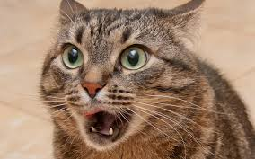
Response- living things “respond” to stimuli (noise, heat, light)

