Slide 1
Name Vocab Quick Notes on Energy Pyramids
1. An energy pyramid is a diagram that shows how energy is transferred between levels of a food chain.

Slide 2
2. Energy travels up the pyramid according to the “rule of 10%”.
This rule means that only 10% of the energy available in that level of the food chain is passed up to the next level.

Slide 3
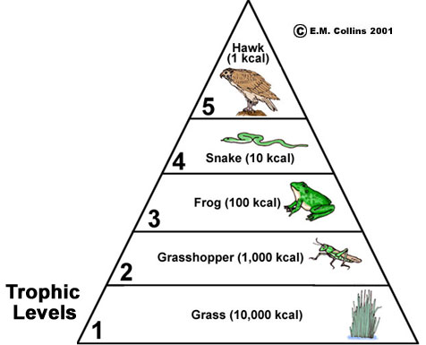
3. Example

