Slide 1
Energy Flow
Energy in an ecosystem originally comes from the sun
Energy flows through Ecosystems from producers to consumers
Producers (make food)
Consumers (use food by eating producers or other consumers)

Slide 2
Producers
Sunlight is the main source of energy for most life on earth.
Producers: An organism that can make its own food.
(Plants are Producers!)

Slide 3
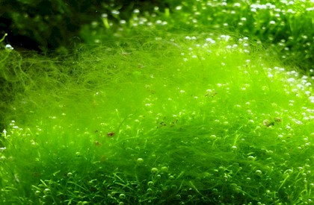
Example
Producer That Captures Energy from the sun by:
Photosynthesis
Adds Oxygen to the atmosphere
Removes Carbon Dioxide from the Atmosphere
Algae

Slide 4
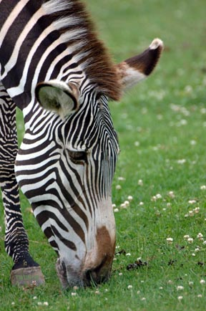
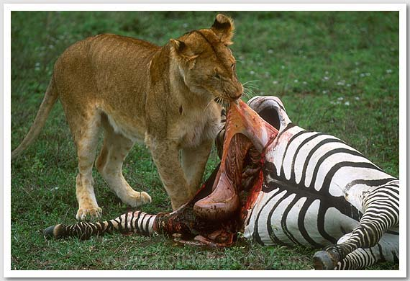
Consumers
An organism that obtains energy by feeding on other organisms.
Herbivores
Eat Only Plants
Carnivores
Eat Only Other
Animals

Slide 5
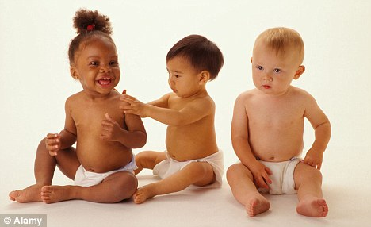
More Consumers
Omnivores (Humans)
Eat Plants & Animals
Scavengers
- A carnivore that feeds on
the bodies of dead organisms.

Slide 6
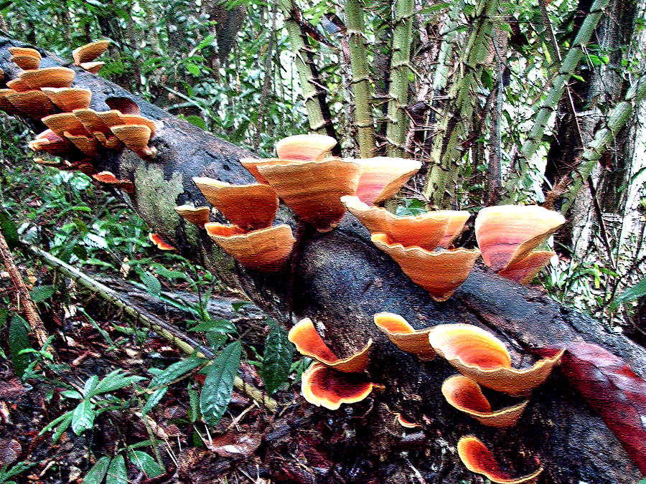
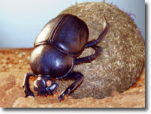
Decomposers
Organisms that break down waste and dead organisms and return the raw materials to the environment.
Examples:
Bacteria,
Fungi
(mold and mushrooms)
Worms
Dung Beetles

